Slide 1
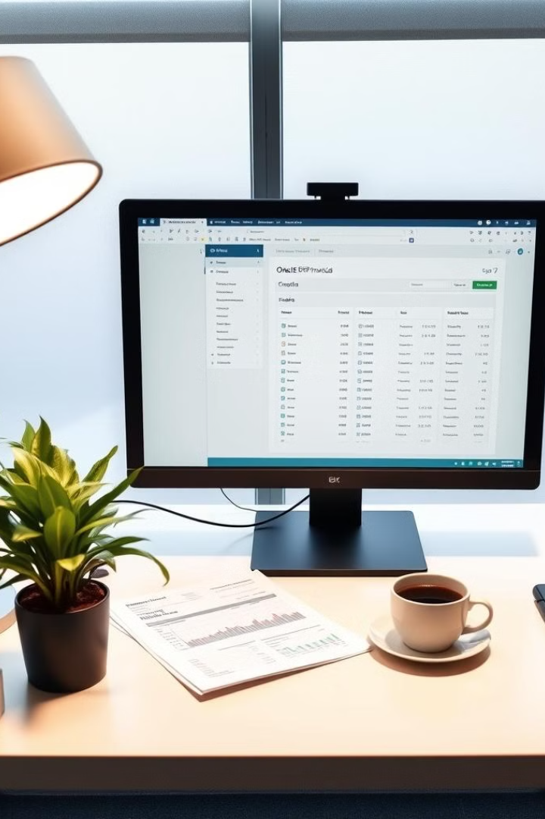
Accounts Receivable Operations in Oracle ERP
This presentation covers key aspects of managing Accounts Receivable in Oracle ERP, including customer invoicing, payment processing, and period closing. Learn essential skills for streamlining AR operations and financial reporting.

Slide 2

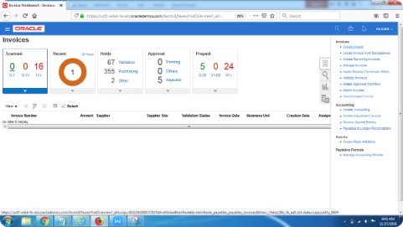
Creating Customer Invoices
Navigate
1
Go to Transactions → Transactions in Oracle ERP.
2
Enter Details
Select invoice type, customer, and enter line items.
Review and Post
3
Check for accuracy and post the accounting entry.

Slide 3




Auto-Invoicing Process
Import Data
Upload data file via AutoInvoice Import.
Validate
Review AutoInvoice Execution Report and address issues.
Post
Finalize auto-generated invoices in Transactions.

Slide 4

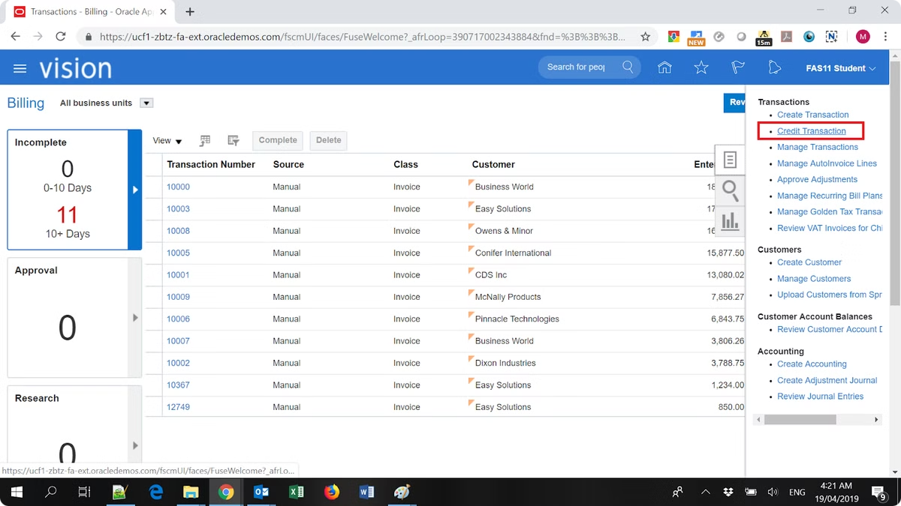
Invoice Adjustments and Credits
Locate Invoice
Find the invoice to adjust in Transactions.
Create Credit Memo
Use Balance Credit action for full invoice amount.
Post and Review
Post adjustment and check updated customer balance.

Slide 5

Recording Customer Payments
1
Enter Payment
Navigate to Receipts and select payment method.
2
Apply to Invoice
Match payment to relevant invoice.
3
Post Transaction
Save and post via Accounting Final Create.

Slide 6

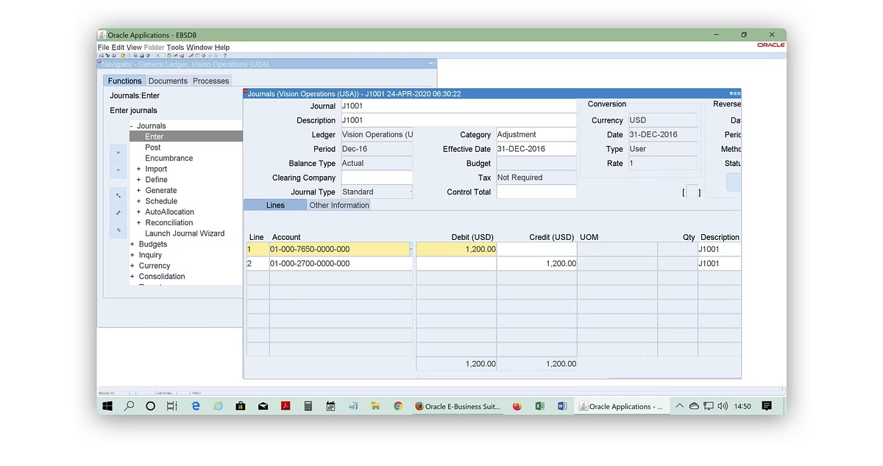
Managing Unapplied Receipts
1
Access Unapplied Receipts
Navigate to Receipts → Unapplied Receipts in Oracle ERP.
2
Select and Apply
Choose the unapplied receipt and match it to the correct invoice.
3
Finalize
Save the transaction and post it to update the customer's account.

Slide 7

AR Period-End Close Process
Review Transactions
Ensure all invoices, payments, and adjustments are posted.
Generate Reports
Run key AR reports like Customer Balance Summary.
Close Period
Navigate to Period Close and confirm closure.

Slide 8
Reconciliation with General Ledger
Generate Report
Review Discrepancies
Make Adjustments
Create reconciliation report comparing AR sub-ledger with General Ledger.
Investigate any differences at the transaction level.
Correct discrepancies in sub-ledger or General Ledger as needed.

Slide 9

Write-offs and Bad Debts
Identify Accounts
Use Aging Report to find uncollectible accounts.
Process Write-off
Create credit entry for uncollectible amount in Receipts.
Update Reports
Rerun financial reports to reflect write-offs and adjustments.

